Slide 1
Rungta International Skills University (RISU)
Fundamentals with C
Project File .
Guided by :- Presented by :-
Ms Naina Devi Ritesh Sharma
IBM SME EPR – 11181
Class – 1/B

Slide 2
Introduction
Project: Auto Generate README.md
Creates README using user inputs
Used for GitHub projects

Slide 3
Tools & Technologies
GCC Compiler
VS Code
GitHub

Slide 4
Move to Project Code
Open source code in VS Code
Explain folder structure
Main file execution

Slide 5
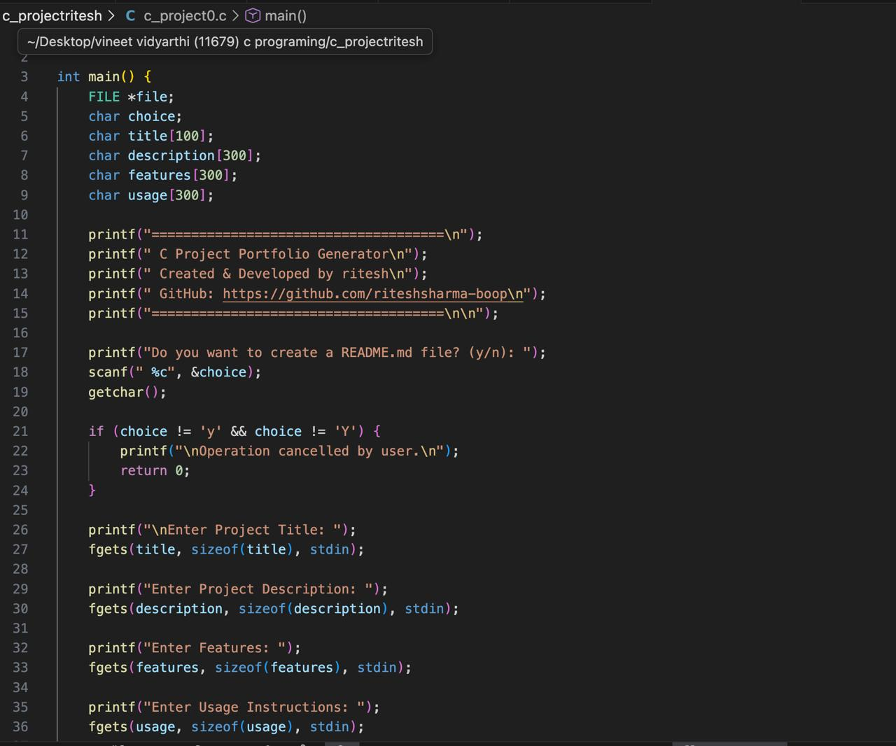
Code

Slide 6
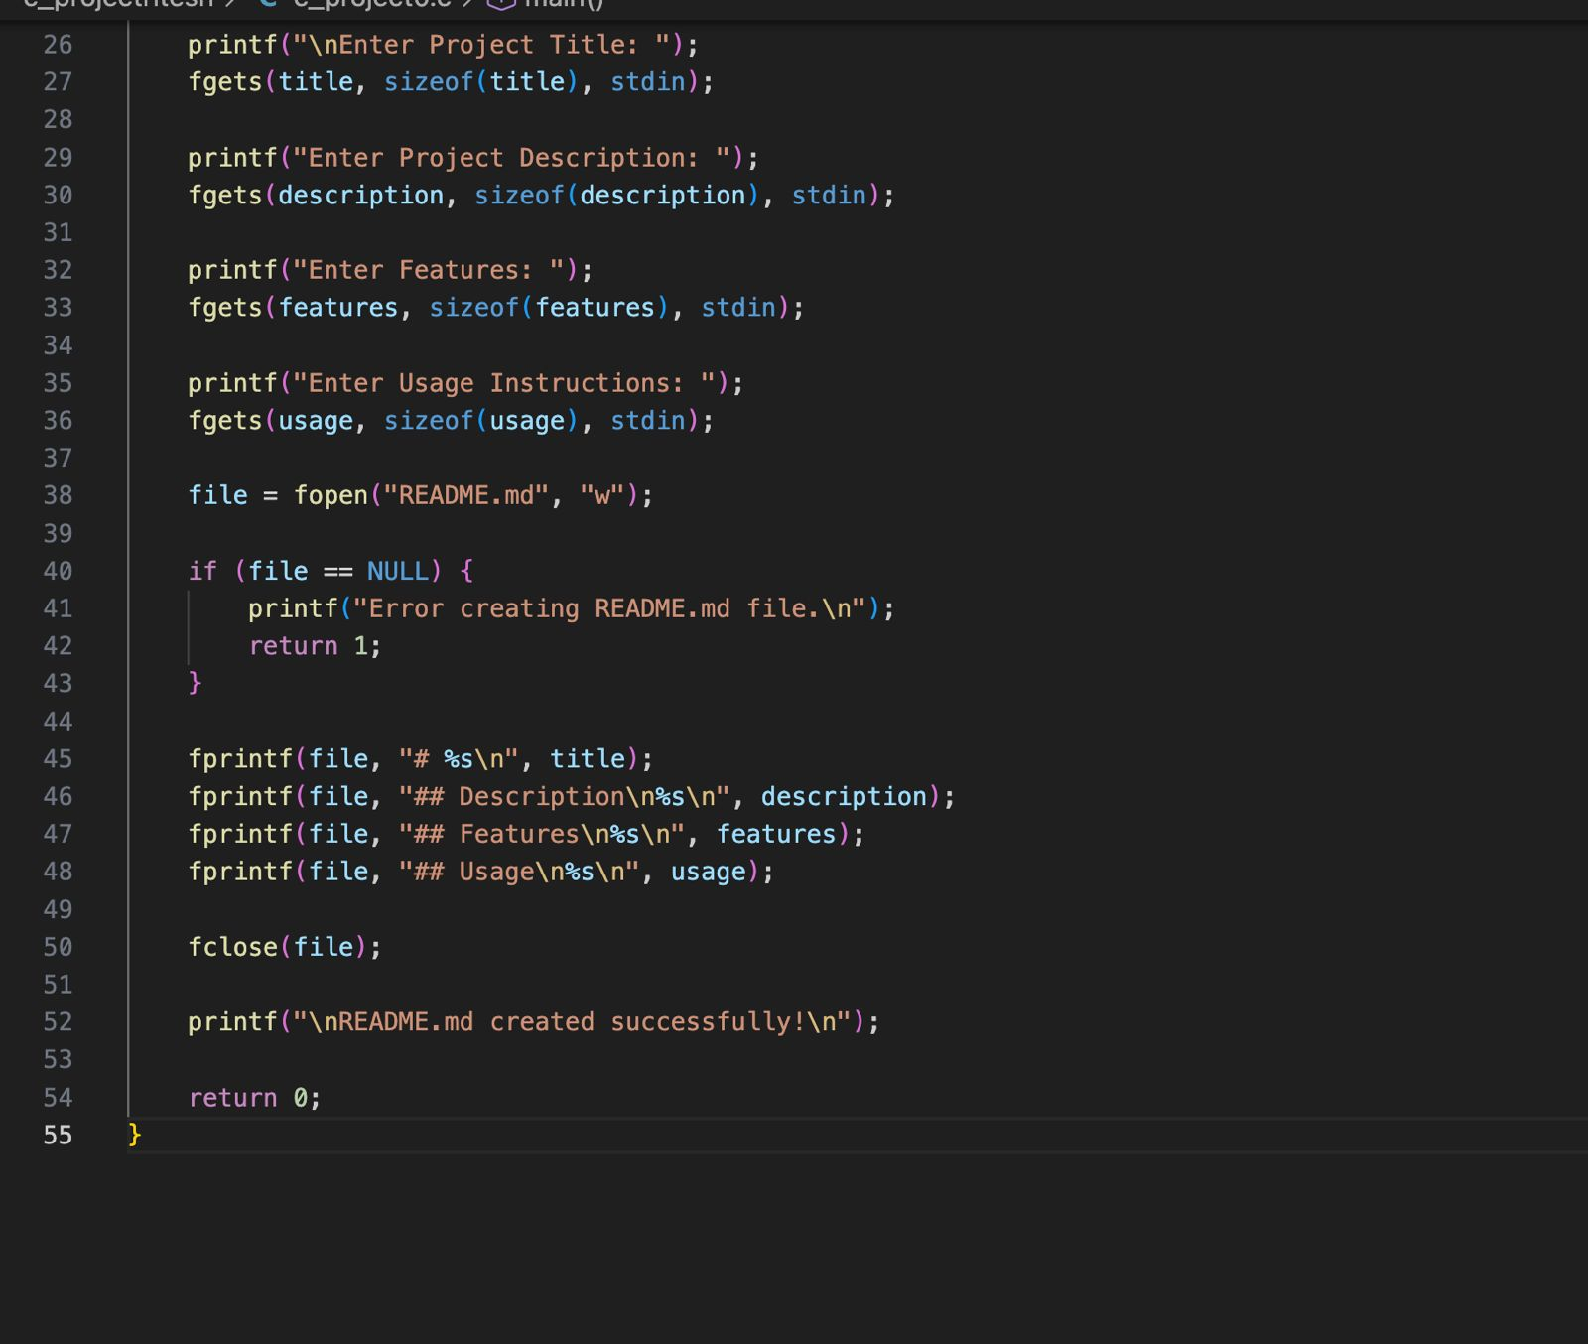

Slide 7
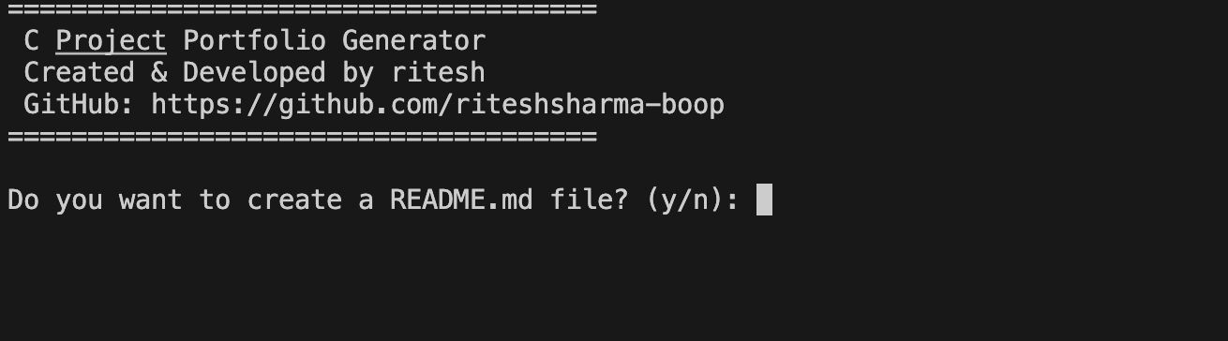
Output

Slide 8
Core Logic of Project
Takes user input
Processes data
Generates README.md file

Slide 9
Function Explanation
Function to accept inputs
Function to format README
Function to save file

Slide 10
Working of Project
Run the program
Enter inputs once
README generated automatically

Slide 11
Execution Flow
Perform once
Generate output
Exit program

Slide 12
Applications
Student projects
Open-source repositories
Professional documentation

Slide 13
Advantages
Saves time
Easy to use
Beginner friendly

Slide 14
Future Scope
GUI based generator
Multiple templates
Direct GitHub upload

Slide 15
  THANK YOU

